Slide 1




PFE PRESENTATION
A FIX-enabled application:
Design and implementation of an electronic trading platform
that validate and parse FIX messages
for Quality Assurance team
Advised by:
Mr. GARGOURI Khalil
Mrs. MEZNI Hanen
Presented by:
TRABELSI Haythem
Notes:
- Hello, My name is Trabelsi Haythem, and welcome to my end of studies presentation.
- So thank you to my committee and the members of the jury for evaluating this project,
- Also I would thank my supervisors Mr Gargouri Khalil and Mrs Mezni Hanen for their immense help during this internship.
- Today’s presentation will be on FIX-enabled application which is an electronic trading platform that validate and parse FIX messages with a simulator for Quality Assurance team.

Slide 2


PLAN
1. Project Context
2. Analysis & Specification of
Requirements
3. Architecture & Conception
4. Realization
5. Conclusion
and Work perspectives

Slide 3


01
PROJECT CONTEXT

Slide 4

LINEDATA
HOST ORGANISATION
700 Clients
20 years of experience
1100+ employees
Notes:
I will present the host organization, Linedata is a global solutions provider with 700 clients operating in 20 offices covering 50 countries and has more than 1100 employees .
The company offers services and outsourcing to different profiles in the domain of lending & leasing and insurance
asset management,
The graph before you shows some of the services that Linedata provides such as Trading management, order and risk management etc . . .

Slide 5

INTRODUCTION
Electronic Trading Platforms
Notes:
Information technology is used to bring together buyers and sellers through an electronic trading platforms and network to create virtual market places.

Slide 6


PROBLEMATIC
TESTING!
Notes:
As business opportunities continue to change in today’s rapidly evolving marketplace, the result is an increase in data flow and processing loads.
All these various reasons have led to the emergence of the need for testing trading systems.

Slide 7



PROJECT CONTEXT
FIX PROTOCOL
Financial Information eXchange Protocol
FIX 4.2
FIX engine:
Notes:
FIX Protocol is a protocol designed for exchanging electronic messages for financial information.
A standard messaging protocol -platform independent- facilitates electronic communication between buy side institutions and brokers.
Typically, a FIX implementation exists as a FIX Engine.

Slide 8
FIX SESSION
PROJECT CONTEXT
Initiator
Acceptor
Disconnected
TCP connection
TCP connection is established
Logon
Logon
FIX connection is established
Notes:
The first important step before exchanging messages is to establish a connection between traders and brokers.
There are two roles for counterparties:
Once roles are defined fix session should be established between both.
A session is uniquely identified by FIX protocol version and IDs of both counterparties.

Slide 9
PROJECT CONTEXT
Overview of FIX communication (FIX Message)
8=FIX.4.2|9=126|35=A|49=theBroker.12345|56=CSERVER|34=1|52=20170117-08:03:04| 57=TRADE|50=any_string|98=0|108=30|141=Y|553=12345|554=passw0rd!|10=131|
Tag=Value | Tag=Value | Tag=Value |…
System messages
Application messages
Notes:
As you can see, the repeatable pattern found in each FIX message is …
Depending on the purpose of each message, different set of tags and values are required each time.

Slide 10





System Messages
Application Messages
Logon (Tag 34 = A)
New Order Single (Tag 35=D)
Heartbeat (Tag 34 = 0)
Execution Report (Tag 35=8)
Logout (Tag 34 = 5)

Slide 11
Constructing a FIX Message
8=FIX.4.2|…|
…|56=MSFT|…|
|10=062|
PRE-TRADE
TRADE
POST-TRADE
Header
Body
Trailer
2
1
3
Notes:
A FIX message is composed of the three major parts, the header, the body and the trailer.
Therefore, in order to create messages with correct values we should construct the message in the following order
Body contains business data
Header contains information needed for session identification
Trailer checksum for message validation

Slide 12
BODY
New Order Single (Tag 35 = D)
HEADER
BeginString
SenderCompID
Quantity
TargetCompID
Side (Buy or Sell)
BodyLength
Symbol
MsgSeqNum
Order Type
MsgType
SendingTime
Time In Force

Slide 13

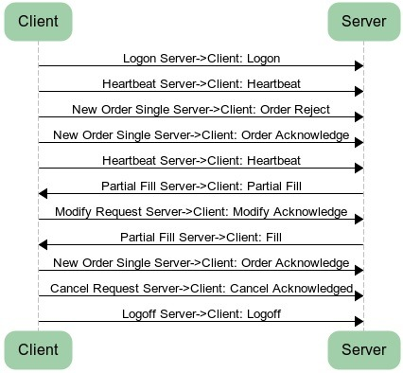

TESTING
Electronic trading
Platforms
Notes:
The testing of FIX messages could be a pretty complicated task.
The combination and complex business logic could be made through a very difficult testing task and elaborate different scenarios.
As shown in the example figure.
There’s a necessity to use a testing simulator.

Slide 14


STATE-OF-THE-ART
Review of the existing FIX simulators
VeriFIX
Linedata’s Broker Simulator
8000 $/Month
Native to Linedata
Allow manual and automated testing
Complex
Easy
Deployed solution
Desktop application

Slide 15

Proposed solution
Steps involved in the process of communicating with a FIX server (simulator):
1. Construct a FIX message
2. Transmit a FIX message
3. Receive a FIX message
4. Parse a FIX message

Slide 16
Proposed solution
FIX message validation
Validate empty field values
Validate field values
Validate required fields
Validate field type

Slide 17
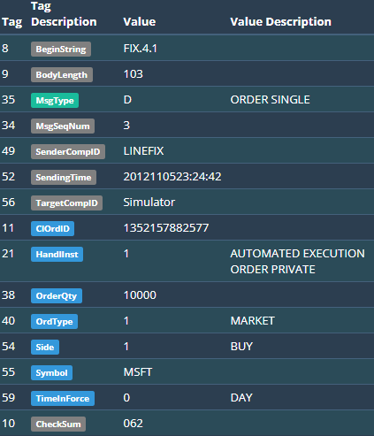
Proposed solution
Parsing FIX messages
8=FIX.4.1|9=103|35=D|34=3|49=LINEFIX|52=2012110523:24:42|56=Simulator|11=1352157882577|21=1|38=10000|40=1|54=1|55=MSFT|59=0|10=062|
Notes:
A raw FIX message is not a very readable format since it was designed with efficiency in mind rather than understandability.
Therefore, for our application we need to develop a process of translating information provided
in order to be presented in a readable format.

Slide 18
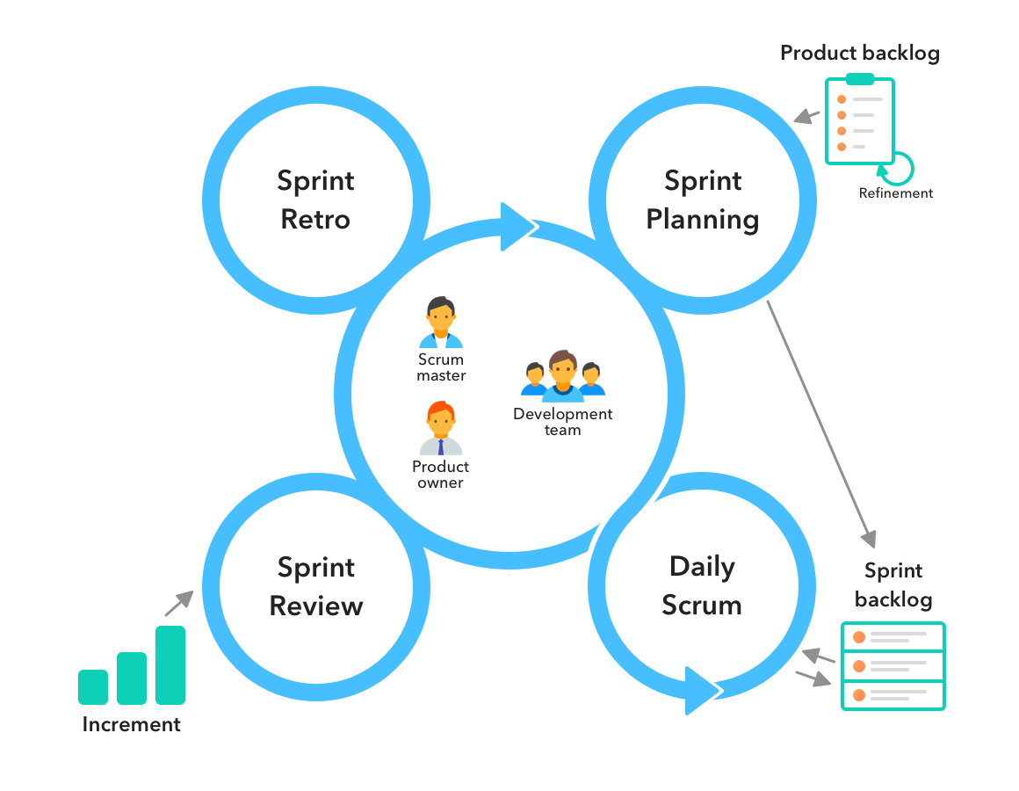
PLANNING PHASE
Work methodology
UML Language Diagrams
Framework SCRUM
Notes:
Throughout this project we used UML language diagrams and SCRUM as our work methodology

Slide 19
SPRINT PLANNING
Authentication and
Orders management
Parsing FIX
messages
Sprint 1
Sprint 2
Sprint 3
Placements and
Executions management

Slide 20
02
Analysis & Specification
Of requirements

Slide 21

SYSTEM ACTORS
LQA User
Linedata’s Broker Simulator
Linedata Quality Analyst
(Broker Side)
(Trader)

Slide 22

Authenticate
FUNCTIONAL
REQUIREMENTS
Manage Orders
- Create an Order
- View Trader desk
Manage FIX session
Manage Placements
- View placements list
- Submit a placement
- Create different scenarios for placements
Manage Executions
- View executions list
Parse FIX message

Slide 23
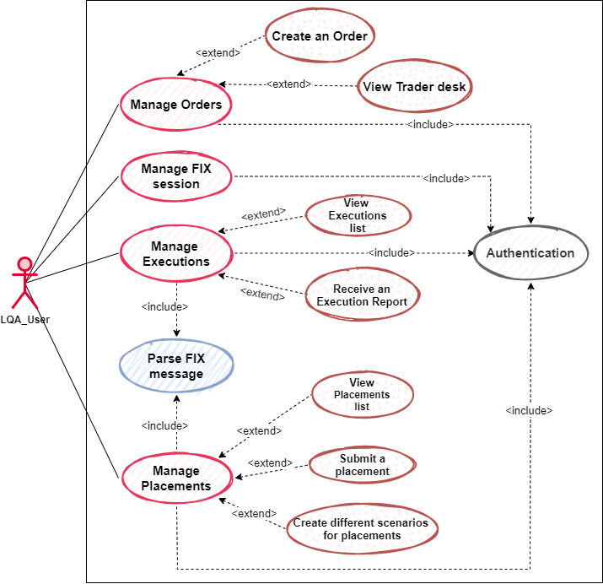

General
Use-Case
Diagram

Slide 24



NON-FUNCTIONAL REQUIREMENTS
1
2
3
Security
Scalability
Performance
Notes:
Security Our platform data should be protected against attacks or unapproved access.
Scalability: Our platform should work under the highest workloads
Performance: this solution must have a minimal time to display in the browser and low latency.

Slide 25

03
Architecture
&
Conception

Slide 26
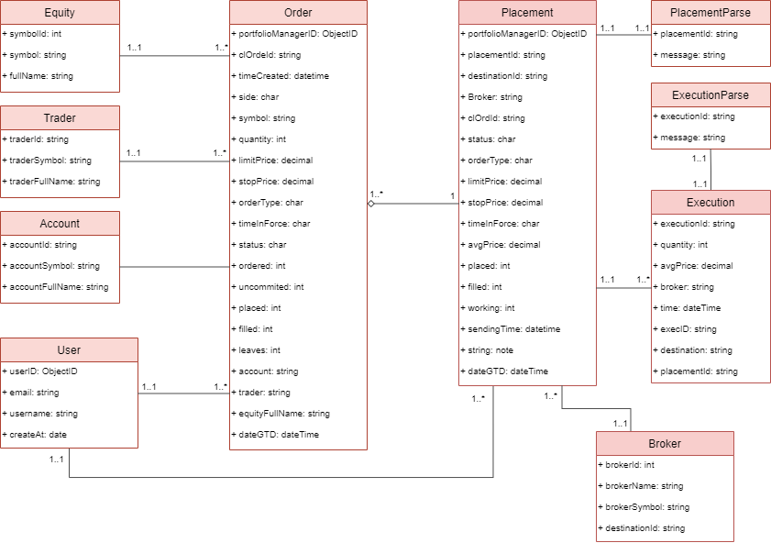
CLASS
DIAGRAM

Slide 27
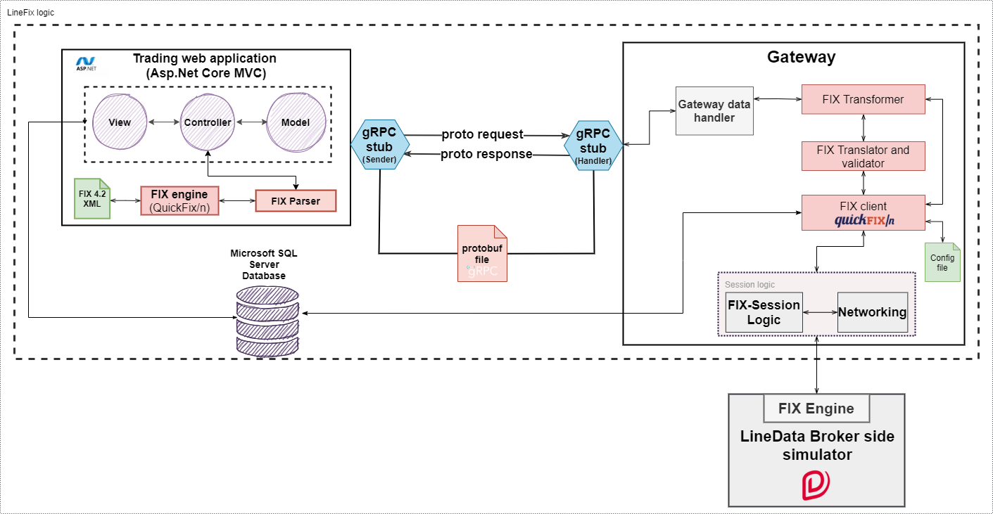
System Architecture

Slide 28
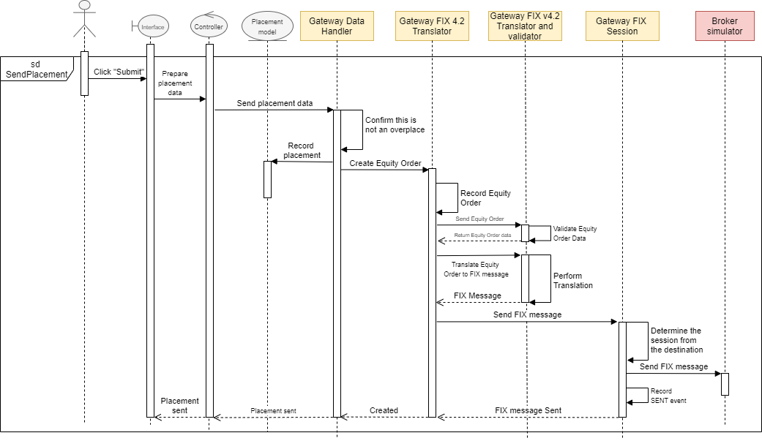
Send Placement Sequence Diagram

Slide 29
04
REALIZATION

Slide 30




USED
TECHNOLOGIES

Slide 31


Work
Environment

Slide 32
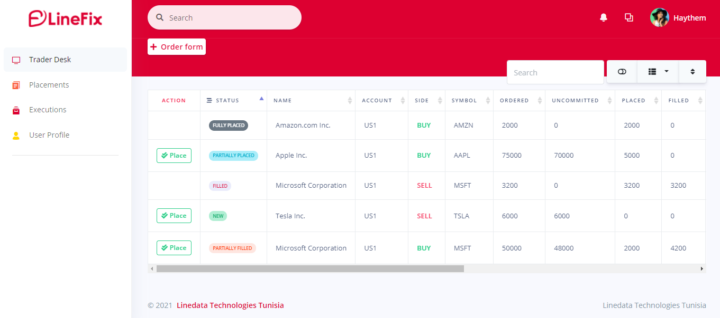
Trader desk (Dashboard)

Slide 33
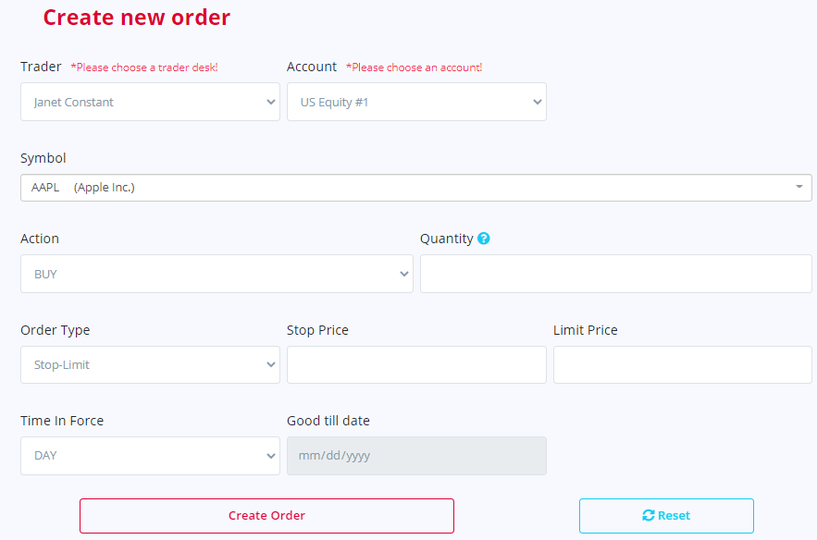
Create Order
Form
interface

Slide 34
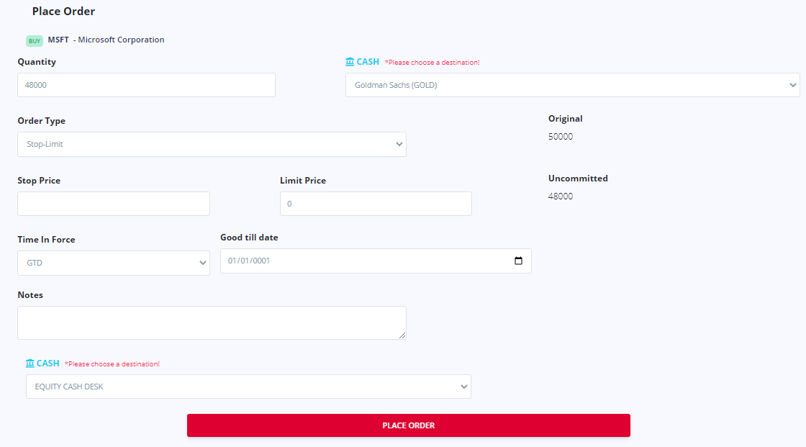

Slide 35
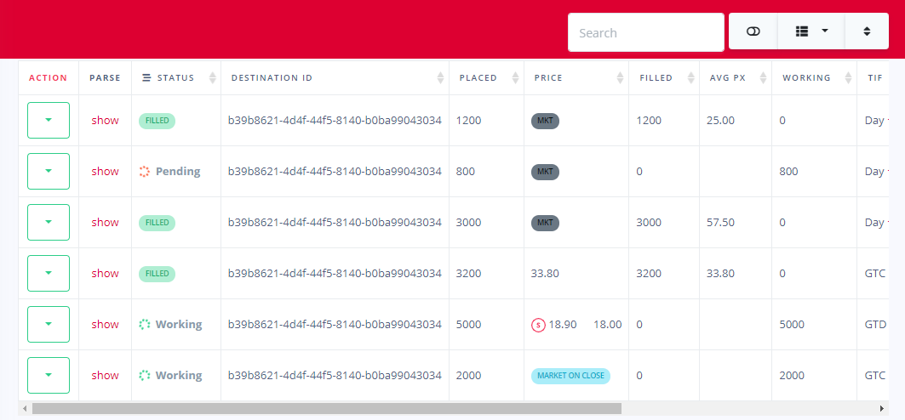
Placements Interface

Slide 36
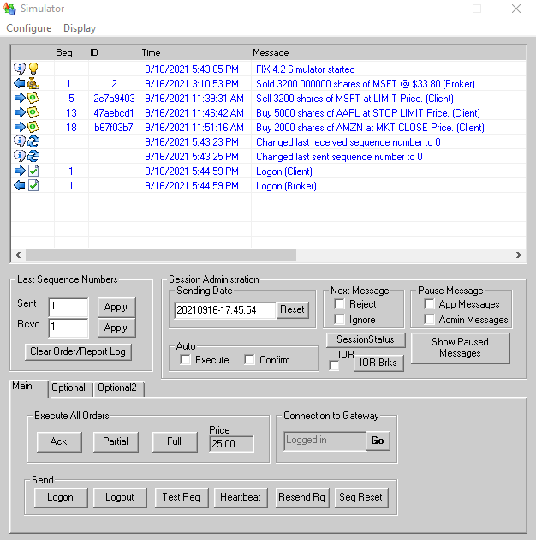
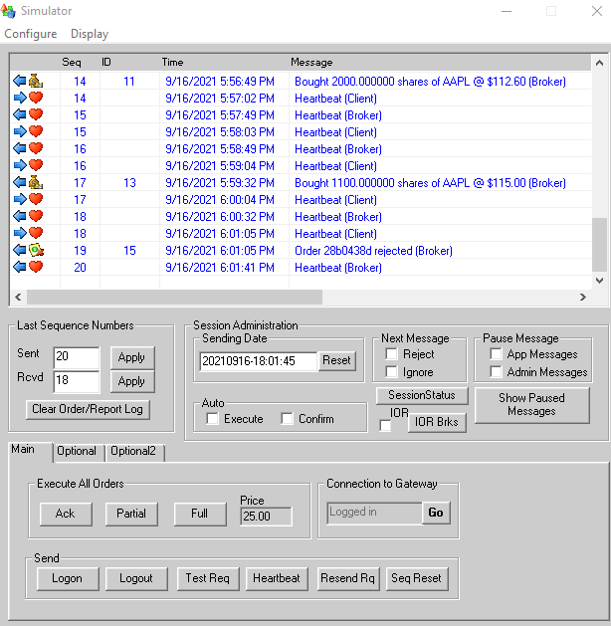
Simulator Interface (1/2)

Slide 37
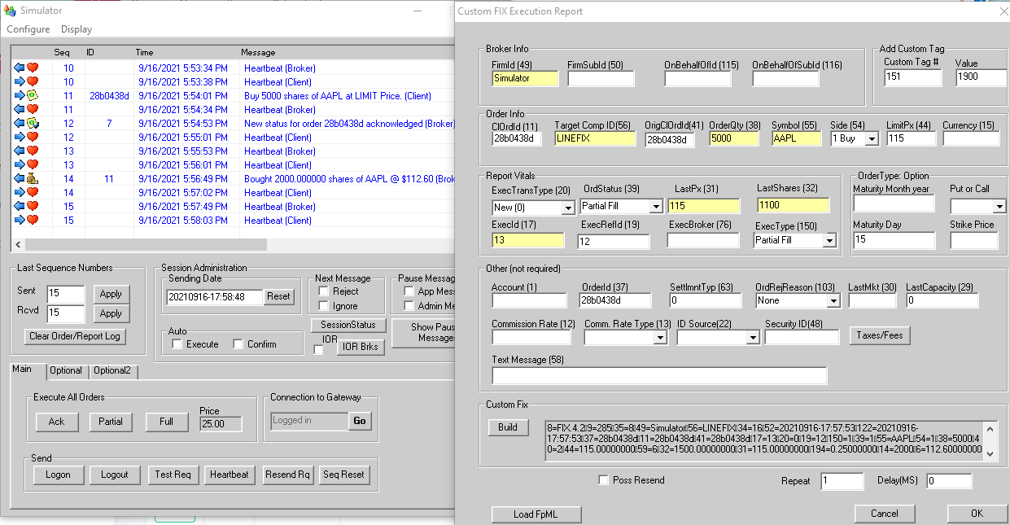
Simulator Interface (2/2)

Slide 38
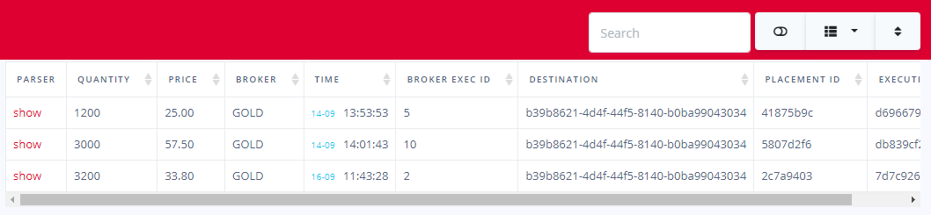
Executions Interface

Slide 39
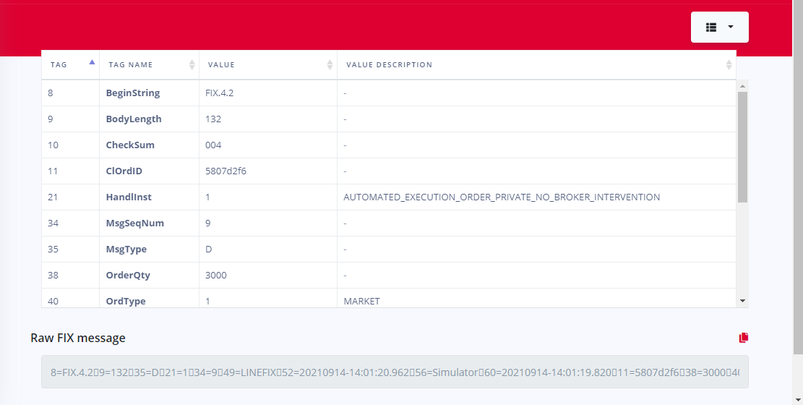
FIX Parser Interface

Slide 40
&
CONCLUSION
PERSPECTIVES
Notes:
In conclusion this internship and project was very rewarding in terms of knowledgment and acquiring new skills while working with professional team that put out the fruit of our engineering study into real projects.
This solution is by no means a bullet proof application and was kept as simple as possible to allow QA analysts to easily understand the concept of using FIX messages.
Thus we can enhance it by adding . . .

Slide 41
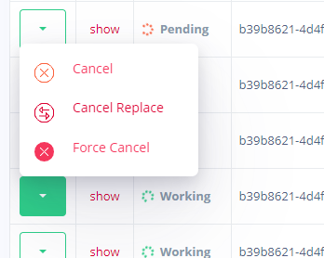
PERSPECTIVES (1/2)S

Slide 42

PERSPECTIVES (2/2)S
Microservices

Slide 43
THANK
YOU
☺

